Slide 1
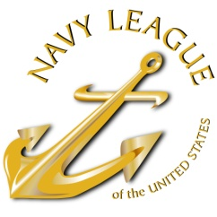
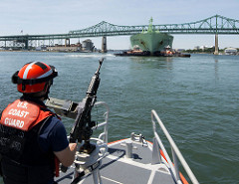
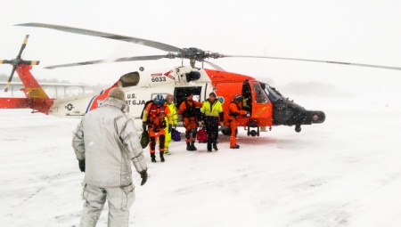
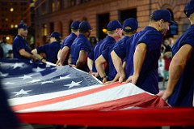
Navy League of the United States
Semper Paratus: The Always-Ready
U.S. Coast Guard
For (Congressman/woman), (State/District), (Month) (Date), 2017
Notes:
Acknowledgement
First, thank you for giving me an opportunity to speak with you today.
I have two objectives today:
Provide a brief review of our Navy League history, purpose, and local initiatives.
Share with you the critical challenges faced by our Coast Guard in carrying out their mission.
Thank you for the unwavering support Congress has shown the Coast Guard

Slide 2
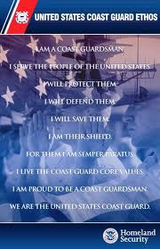
Agenda
History of the Navy League
Overview of Coast Guard roles and missions
Current Priorities: FY2018 Funding, Recapitalization and Building Capacity
Closing Comments

Slide 3
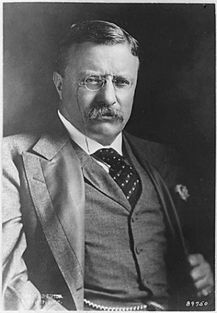
The Navy League of the United States
Founded in 1902 with the support of President Teddy Roosevelt
Promotes the need for strong sea services
Civilian organization
230 Local Councils
42,000 members worldwide
Our Goal: to educate the public and elected officials on the importance of a strong maritime component for our National Security
Supports and advocates for members of the Navy, Marine Corps, Coast Guard, and U.S. Flag Merchant Marine
Notes:
Please tailor the discussion to your local council:
__#__ NL members-strong; more than __ in the state of -----.
Civilian Volunteers come from a variety of backgrounds, but all believe in strong sea services.
Key Activities: Junior Navy and Marine Corps ROTC, Adopt-a-Ship, public education on sea services, ship commissionings, Naval Sea Cadets Corps

Slide 4
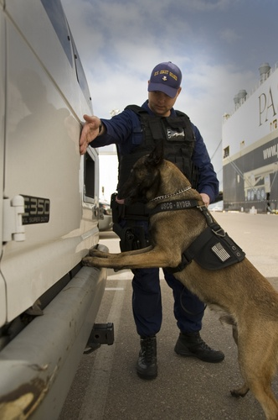
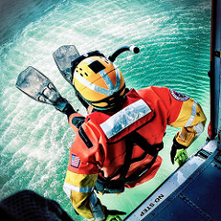
An Overview of the United States Coast Guard: 11 Statutory Missions
Ports, waterways, and coastal security
Drug interdiction
Immigrant Interdiction
Aids to navigation
Search and rescue
Marine environmental protection
Marine safety
Ice operations
Living marine resources
Defense readiness
Law enforcement
The only organization that is:
a military service, federal law enforcement agency, and our nation’s lead maritime first responder with the mandate to act. The Coast Guard is military, multi-mission, and maritime.
Notes:
2016 year in review is not yet published. During 2015, the Coast Guard:
Surpassed its 2014 mark of 140 metric tons of illegal drugs from the maritime domain, interdicting 179 metric tons.
Detained 503 suspected smugglers for prosecution in the United States.
In less than a month, the Cutter BERTHOLF: conducted 12 drug interdictions, confiscated over 33,000 pounds of cocaine, and detained 32 suspected smugglers. These operations included a record-breaking recovery of 15,000 pounds of cocaine from a single self-propelled semi-submersible smuggling vessel.
Captured $4.9 billion Wholesale value of illegal narcotics.
Interdicted 6,000 undocumented migrants attempting to illegally enter the United States by maritime routes.
Responded to over 16,400 Search and Rescue (SAR) cases, resulting in over 3,500 lives saved. In one example, a Coast Guard rescue swimmer deployed to assist a fishing vessel overcame 5 ft seas, 30 mph winds, 57 degree water, and a pitch-black night, and swam nearly a mile to individually tow four fishermen from their life raft to shore, saving all four lives.
Directed cleanup efforts, which involved 10 federal, state, and local government agencies, Native American tribes, and 55 environmental non-governmental agencies in response to the oil pipeline discharge in Los Angeles/Long Beach in May 2015.
Conducted over 20,700 container inspections and monitored 1,024 cargo transfers to ensure security of the maritime domain.
Inspected more than 4,200 marine facilities for compliance with safety and environmental protection regulations.
Conducted over 4,000 safety and security examinations on vessels operating on the Outer Continental Shelf.
Investigated over 5,200 reportable marine casualties involving commercial vessels.
Screened 131,276 merchant vessels for potential security threats.
Conducted 20,775 waterborne patrols of critical maritime infrastructure, escorted over 1,955 high-capacity passenger vessels and conducted nearly 8,600 security boardings in and around U.S. ports.

Slide 5
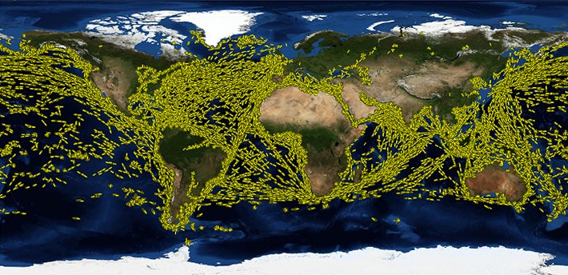
The U.S. Maritime Environment
95,000 miles of shoreline
Waterborne trade carries over 1.3 billion metric tons of cargo each year. Another billion tons of cargo is carried in domestic waterborne movements.
$4.5 trillion of economic activity is generated by the Maritime Transportation System
One of every six jobs is marine-related.
Maritime transportation is the lifeblood of our national economy and fuels the global economy.
The Coast Guard is imperative to our economic security!
Notes:
USCG’s maintenance of more than 47,000 navigation aides ensured the safe transport of these goods.
The seas link the Nation with world trade and commerce. Utilizing the seas allows us to project military power beyond our shores, protect important U.S. interests, and assist allies and friends. Alternatively, the seas also serve as highways for criminal and terrorist threats that honor no national borders.
Map is a NASA image of all ships transporting goods at a single 24 hour period.
1.3 billion tons and billion tons of cargo statistics from the Transportation Institute. Job number from NOAA. $4.5T is from USCG Commandant at Brookings, December 2016.

Slide 6
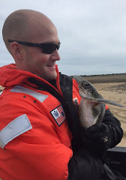
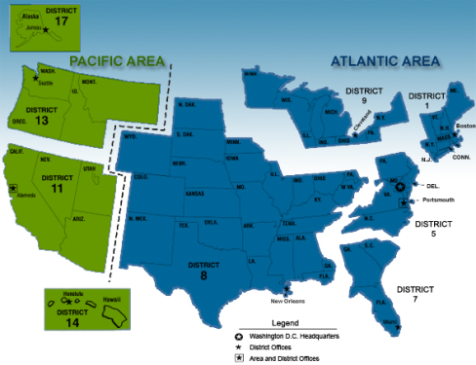
On an average day, the Coast Guard…
Conducts 45 search and rescue cases;
Saves 14 lives;
Seizes 1,214 pounds of cocaine and 144 pounds of marijuana
Interdicts 17 undocumented migrants;
Screens 329 merchant vessels for potential security threats prior to arrival in U.S. ports;
Conducts 13 fisheries conservation boardings;
Services 82 buoys and fixed aids to navigation;
Facilitates movement of $12.6B worth of goods and commodities through the Nation’s Maritime Transportation System.
Investigates 32 pollution incidents;
Notes:
Each day, the men and women of the 42,000 plus active duty Coast Guard, 7,899 Reservists, and 32,000 Auxiliarists provide services over 3.4 million square miles of Exclusive Economic Zones.
However, due to constrained resources, the USCG cannot respond to everything. Only 10% of known drug traffic flow can be disrupted (USCG State of the Coast Guard, Admiral Zukunft, speaking at Brookings Institute. December 2016).
Statistics from the latest Coast Guard budget request: https://www.uscg.mil/budget/docs/FY18/FY%202018%20Budget%20Overview_WEB%20FINAL.pdf

Slide 7
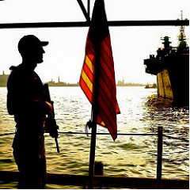
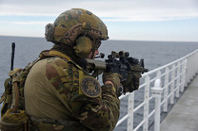
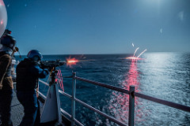
Evolving Threats to Homeland Security
The Coast Guard has five areas of strategic focus that drive USCG operations and capital investments:
The rise of transnational organized crime networks
The imperative for southern border security
Increasing maritime commerce
Emerging cyber risk
Future challenges in the polar region.
Notes:
For details on the problems and the Coast Guard’s approach, please see the P2 Q&A number 6 and pages 18-19 of the Maritime Policy Statement.

Slide 8
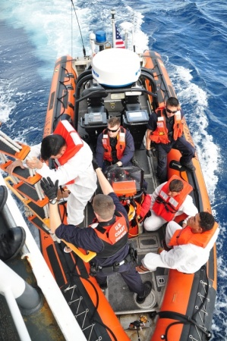
A National Imperative
History has demonstrated that a strong maritime capability is a key characteristic of great nations, and challenges to our maritime dominance are beginning to emerge.
Our country’s fleets, both Navy and Coast Guard, have declined to the point where they are losing their ability to meet all the commitments placed on them.
The Navy League recommends: Funding the Acquisition, Construction, & Improvements (AC&I) budget at $2B/year
Notes:
We need the Coast Guard more than ever (all from the Commandant’s speech at Brookings December 2016).
The Western hemisphere has incredible levels of violence—the murder rate in Honduras is higher than that of 2007 Iraq. DOD is stretched elsewhere (Pacific pivot, Russian aggression, ISIS), so USCG focuses on the Americas (Western Hemisphere Strategy published late 2014). Focus is on migrant & drug interdiction, transnational crime.
Energy renaissance: the U.S. is on track to be a net energy exporter by the 2020s. The majority of those exports will travel by our Maritime Transportation System. The USCG ensures the MTS is safe and resilient, ready to handle those shipments and ensure the certification of US flag ships.
Arctic: A new ocean is being created and human activity in the Arctic is increasing. It has an incredible amount of natural resources. We only have one heavy polar ice breaker: Russia has 27 oceangoing ice breakers, both heavy and medium. We must invest in our ice breaker capability. This budget makes a serious investment and Congress must preserve that.
USCG independent review recommends 3 heavy, 3 medium icebreakers to fully meet the USCG’s mission, as does the Department of Homeland Security Strategic Guidance.
If you want a lot of detail, this is a great overview for Coast Guard Icebreaker Modernization: https://www.fas.org/sgp/crs/weapons/RL34391.pdf

Slide 9
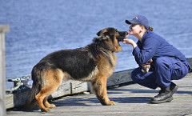
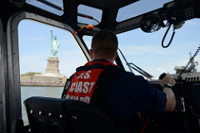
The Coast Guard Needs Your Help
Coast Guard recapitalization is on track, but operations budgets have remained flat even as new assets come online. This means cutbacks elsewhere:
Not enough funds for fuel
Not enough funds for training
Not enough funds for quality of life benefits
The Navy League recommends: 5% per year growth in operations
funding.
Notes:
For details on this issue, please see the Navy League’s testimony before the House Coast Guard & Maritime Transportation Subcommittee: https://transportation.house.gov/UploadedFiles/2017-06-07_-_Acton_Testimony.pdf

Slide 10
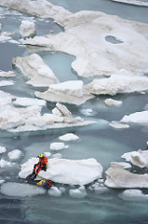
USCG Needs New Icebreakers
The Coast Guard needs 3 heavy and 3 medium icebreakers.
It currently has only one operating heavy icebreaker.
Six different government agencies depend on the Coast Guard having heavy icebreaker capabilities.
Human activity in the Arctic is increasing, and the Coast Guard must be able to respond in a crisis.
Other Arctic nations have a strong presence in the region: the U.S. should too.
The Navy League recommends:
$750 million in FY18 funding for the first new heavy icebreaker
Notes:
The Department of Homeland Security strategic plan, Coast Guard analysis, and an independent study confirm the need for three heavy, three medium.
Six agencies: National Science Foundation, Department of Commerce, Department of Homeland Security, Department of Transportation, Department of State, and the Department of the Interior (EPA).
Human activity in the region includes commercial operations, scientific research, and tourist activities like cruise ships.

Slide 11
FY2018 Coast Guard Priorities
To meet the future demands of our maritime system, we must recapitalize and build capacity. The Navy League supports:
Fund the AC&I Budget at $2B/year to fully fund the Offshore Patrol Cutter and other recapitalization efforts like the inland waterways fleet.
Increase Operations funds by 5% a year to improve readiness and retention.
Deliver at least six new Fast Response Cutters (FRCs) a year.
$750M in funding for the first new heavy polar icebreaker.
Aviation and C4ISR improvements, including polar aviation.
Recapitalize Shore Infrastructure: $1.6B of improvement backlog is funded at about $3M a year.
Notes:
OPCs (25 in program of record; replace the (210’ (13) and 270’ (16) Medium Endurance Cutters (30-50 years old).
The contract for the first OPC hull and options for 8 more was awarded to Eastern Shipbuilding Group, Inc. in Panama City, Florida.
The first OPC is scheduled to be delivered in FY2021. The Coast Guard plans to build 25 OPCs.
FRCs (58 in program of record, 15 have been commissioned) are 154’ replacement for the 110-foot (and 123-foot) patrol boats.
Currently have only one operational icebreaker.
Aviation improvements: aviation assets are key to the Coast Guard’s mission
USCG: United States Coast Guard
NSC: National Security Cutter
OPC: Offshore Patrol Cutter
FRC: Fast Response Cutter
C4ISR: Command, Control, Communications, Computers, Intelligence, Surveillance and Reconnaissance. The improvements are basic; just to ensure the USCG is current and up to date with its C4ISR capabilities, no specific project needs extra funding, should just be funded as requested.
The 2017 Seapower Almanac can be referenced for a complete listing of USCG cutters, other ships, and aircraft

Slide 12
Closing Comments
The Coast Guard plays a critical role in protecting our nation’s waterways, ports, and citizens from emerging threats.
Congress has expanded the roles of the Coast Guard to their limits and it must continue to equip and fund them at reasonable levels.
Congress has been the biggest champion of the Coast Guard. THANK YOU FOR YOUR SUPPORT!
The Navy League recommends:
Funding AC&I at $2B/year
5% yearly growth in Operations funding
$750M for the heavy polar icebreaker in FY2018.
Notes:
Coast Guard needs an annual funding bill
Continue to finish the recapitalization of fleet. We recommend $2B/year and a 4% increase per year in operating costs.
Polar Icebreaker is $1B estimated

Slide 13
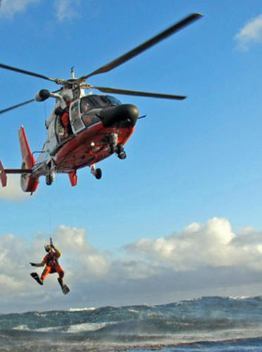
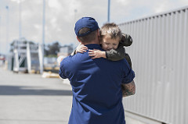
Navy League of the United States
<presenter name>
<title>
<council name>
<presenter email address>
<presenter phone number>
<council website address>
Join the Congressional Shipbuilding Caucus to help ensure USCG has the cutters it needs!
Notes:
Encourage your Representative to join the Congressional Shipbuilding Caucus, if they haven’t already. The Navy League sponsors a quarterly breakfast series with them to explore topics of interest to the shipbuilding community. It’s very bipartisan, co-chaired by Rep. Rob Wittman (R-VA) and Rep. Joe Courtney (D-CT).

